Slide 1

Slide 1
DATA DRIVEN
Research and Investment
Recommendations in the Pharma Sector
Power Point Presentation
Vikshita Kumari Prakash

Slide 2







Agenda
Sector Overview and Initial Research.
Compliance Challenges faced by pharmaceutical companies
Drug Pipelines and R&D Analysis
Regulatory and Compliance Factors
Comparative Analysis
Final Recommendations
Buy side and Hold Side
2

Slide 3
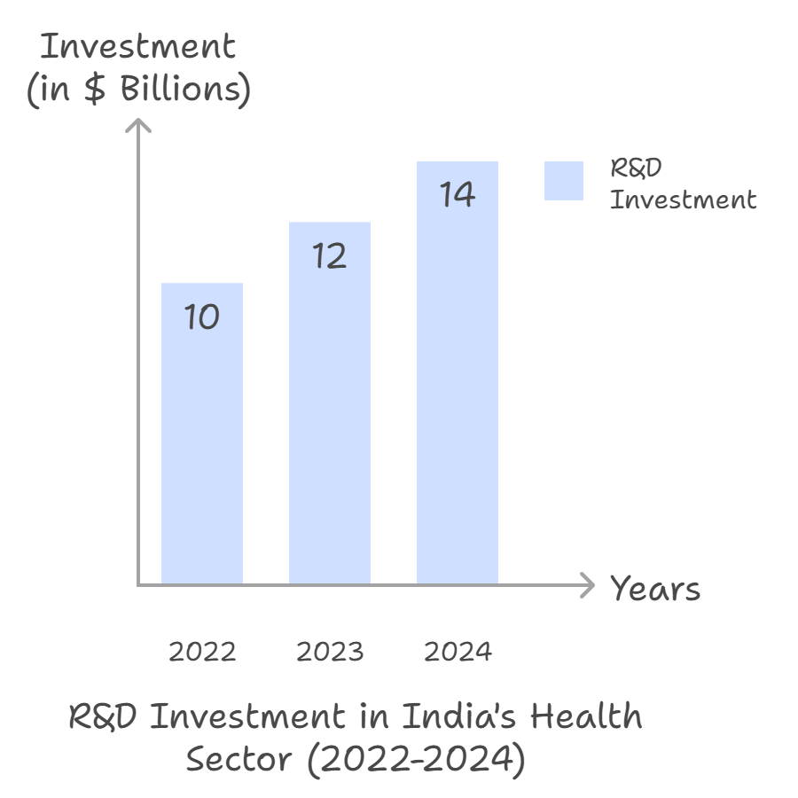
Overview of pharma sector
The pharmaceutical sector is a critical part of the healthcare industry, responsible for the research, development, production, and distribution of medications. The sector is driven by the need to improve global health outcomes through the development of new drugs and therapies.
Investment : The sector invests heavily in R&D to discover and develop new drugs.
In 2022, global pharmaceutical R&D spending was estimated at over
$200 billion and it is projected to exceed $2.5 trillion in 2024. This includes
investments from both public and private sectors.
Get Started
In 2022, The R&D investment in India's health
sector was approximately $10 billion. This figure
Increased to around $12 billion, reflecting a
growing focus on healthcare innovation in 2023
and The investment is projected to reach
$14 billion, driven by advancements in
biotechnology, pharmaceuticals, and digital health technologies in 2024.
3

Slide 4
Drug Development Process:
Discovery and Preclinical Research: Identifying potential drug candidates through lab research and testing. Discovery and Preclinical Identifying potential drug candidates through lab research and testing.
Discovery and Preclinical Research: Identifying potential drug candidates through lab research and testing.
Initial Discovery
Once a drug candidate successfully passes preclinical research, it moves into the clinical trial phase.
Preclinical Research
Phase I: Tests on a small group of healthy volunteers to assess safety and dosage.
Phase I
Phase II: Tests on a larger group of patients to evaluate efficacy and side effects.
Phase II
Phase III: Large-scale trials to confirm effectiveness and monitor adverse reactions.
Phase III
4

Slide 5
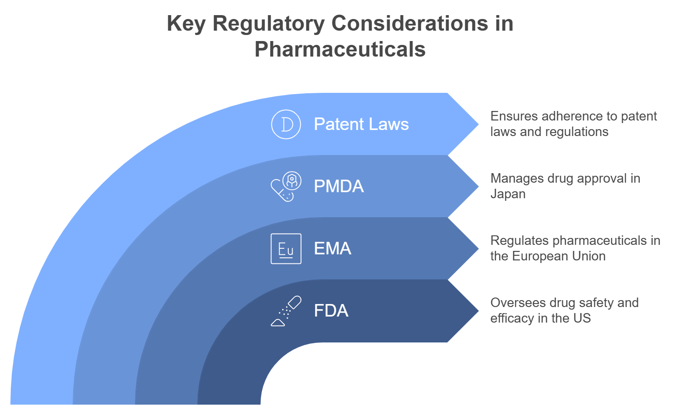
5

Slide 6
Compliance Challenges faced by pharmaceutical companies :
Changing Regulations
1
4
Cost of Non-Compliance
Regulations are frequently updated to address new drug technologies and market trends. Companies must stay abreast of these changes to ensure compliance.
Financial Penalties: Non-compliance with regulations can result in significant financial losses and damage to reputation.
Global Harmonization
2
5
Technological Impact
Varying Standards: Aligning regulatory standards across different countries can be challenging, as companies must navigate varying requirements and ensure compliance in multiple jurisdictions.
Compliance Challenges
Digital Transformation: The adoption of digital technologies in regulatory compliance, including electronic record-keeping, data integrity, and real-time monitoring, is essential but requires significant investment.
Post-Market Surveillance
3
6
Supply Chain Issues
Continuous Monitoring: Ensuring continuous monitoring of drugs for adverse effects and compliance with regulatory standards after market approval is crucial but challenging.
Global Disruptions: Ensuring a reliable supply of raw materials and finished products, particularly during global disruptions, is a major compliance challenge.
6

Slide 7
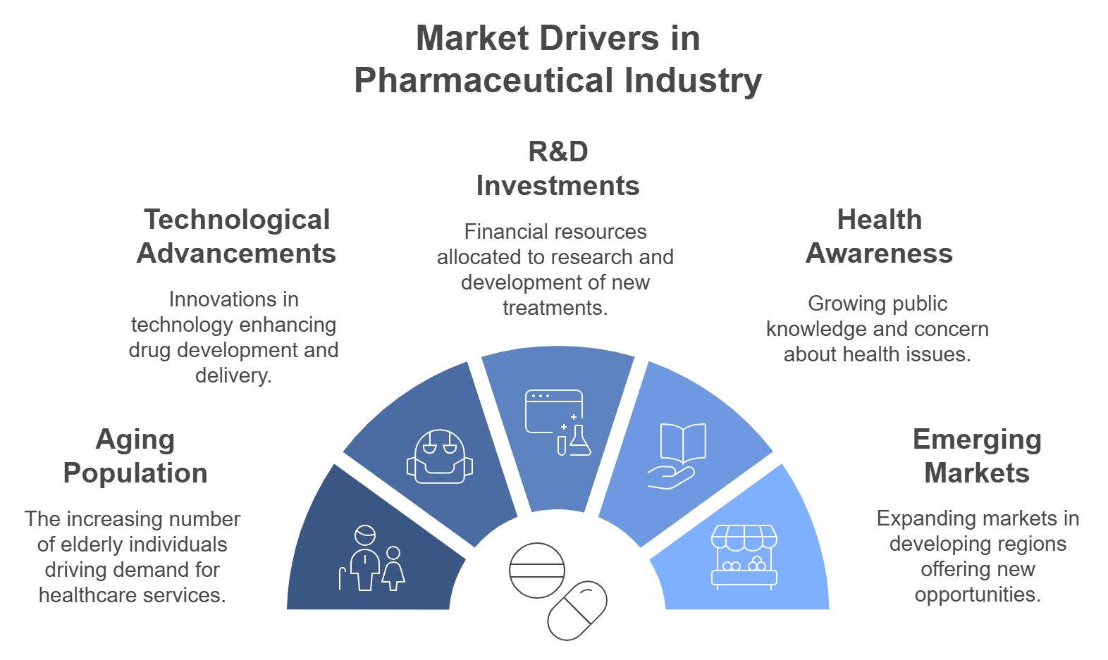
7

Slide 8

Key Therapeutic Areas
Oncology
Immunology
Continues to be a top growth area with new breakthroughs in immunotherapy and gene editing.
Autoimmune diseases like rheumatoid arthritis and psoriasis have increasing treatment demands.
Key Therapeutic
Areas
Alzheimer’s, Parkinson’s, and multiple sclerosis are growing segments due to aging populations.
Orphan drugs for rare diseases benefit from accelerated approvals and higher pricing power
Neurology
Rare Diseases
8

Slide 9
Drug Pipeline and R&D Analysis :
Key Companies and Their Drug Pipelines :
Roche
Pfizer
Novartis
Merck
Pipeline Size: Pfizer has a robust pipeline with numerous products in various stages of development.
Pipeline Size: Merck continues to expand its pipeline with a focus on oncology and vaccines.
Pipeline Size: Roche leads with 218 products in its R&D pipeline
Pipeline Size: Novartis has a strong presence with a diverse pipeline
Focus Areas: Oncology, immunology, and neuroscience.
Focus Areas: Oncology, vaccines, and rare diseases.
Focus Areas: Oncology, neuroscience, and cardiovascular diseases.
Focus Areas: Oncology, vaccines, and infectious diseases.
Upcoming Drugs: Includes novel cancer immunotherapies and treatments for neurological disorders.
Upcoming Drugs: Includes new cancer therapies and vaccines for infectious diseases.
Upcoming Drugs: Includes innovative therapies for multiple sclerosis and novel biologics for autoimmune diseases.
Upcoming Drugs: Includes new cancer immunotherapies and vaccines for diseases like respiratory syncytial virus (RSV).
Potential Impact: Roche's strong focus on oncology and immunology positions it to significantly impact cancer treatment and autoimmune diseases.
Potential Impact: Pfizer's advancements in oncology and vaccines are expected to provide new treatment options and improve public health outcomes.
Potential Impact: Novartis's focus on neuroscience and cardiovascular diseases could lead to breakthroughs in treating chronic conditions.
Potential Impact: Merck's advancements in immuno-oncology and vaccines are expected to enhance cancer treatment and prevent infectious diseases
9

Slide 10
Key Companies and Their Drug Pipelines of India :
Sun Pharma Industries
Dr. Reddy’s Laboratories
Cipla
Lupin
Pipeline Size: Sun Pharma has a diverse pipeline with a strong focus on generics and specialty drugs.
Pipeline Size: Dr. Reddy’s has a robust pipeline with a mix of generics and biosimilars.
Pipeline Size: Cipla has a strong pipeline with a focus on respiratory and HIV/AIDS treatments.
Pipeline Size: Lupin has a diverse pipeline with a focus on cardiovascular and diabetes therapies..
Focus Areas: Oncology, dermatology, and ophthalmology..
Focus Areas: Oncology, gastroenterology, and cardiovascular diseases.
Focus Areas: Cardiovascular diseases, diabetes, and respiratory diseases.
Focus Areas: Respiratory diseases, HIV/AIDS, and oncology.
Upcoming Drugs: Includes biosimilars for cancer treatment and innovative therapies for gastrointestinal disorders.
Upcoming Drugs: Includes novel treatments for skin disorders and cancer.
Upcoming Drugs: Includes new formulations for diabetes management and cardiovascular health.
Upcoming Drugs: Includes new inhalation therapies for asthma and COPD, and antiretroviral drugs for HIV.
Potential Impact: Sun Pharma's focus on specialty drugs and oncology positions it to significantly impact the treatment of skin disorders and various cancers.
Potential Impact: Dr. Reddy’s advancements in biosimilars and innovative therapies are expected to provide new treatment options for cancer and gastrointestinal diseases.
Potential Impact: Cipla’s focus on respiratory and HIV/AIDS treatments could lead to significant improvements in managing these chronic conditions.
Potential Impact: Lupin’s advancements in diabetes and cardiovascular therapies are expected to improve disease management and patient outcomes.
10

Slide 11





Regulatory & Compliance Risks
Regulatory Risks
Potential Impact on Company Performance
Financial Loss: Delays in regulatory approval can delay product launches, preventing companies from realizing expected revenues. Extended approval timelines result in lost market opportunities and deferred earnings.
FDA/EMA Approval Delays: Failure to meet regulatory standards can result in costly delays.
Pricing Pressures: Governments and insurance companies pushing for lower drug prices, particularly in the U.S. and EU
Pressure on Innovation: Companies may face increased difficulty in funding R&D for new treatments, as reduced drug revenues could lead to lower R&D budgets or a shift in focus toward cheaper therapies.
Market Share Erosion : As generics enter the market, the company’s original drug may lose market dominance, especially in the case of non-patented, high-volume drugs.
Patent Expiry: Blockbuster drugs facing expiration lead to generic competition (e.g., Humira).
11

Slide 12
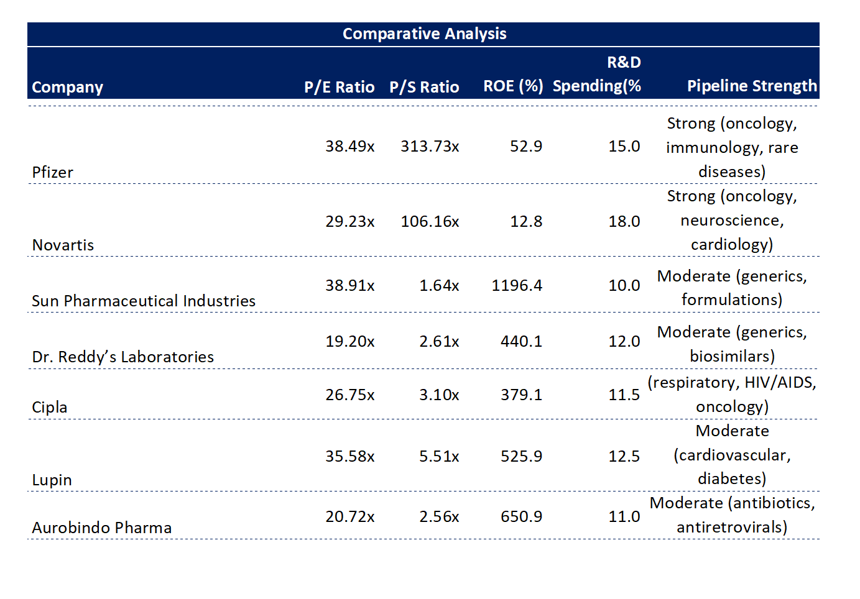
12

Slide 13
Recommendation :
Sun Pharma
Dr. Reddy’s Laboratories
Cipla
Buy Recommendations
Hold Recommendations
Lupin
Aurobindo Pharma
13

Slide 14


Final Recommendations
Sun Pharma: Strong leader in generics and specialty drugs, with a solid pipeline and global presence.
Dr. Reddy’s Laboratories: Expanding in biosimilars and specialty generics, with strong market penetration in the U.S. and Europe.
Cipla: Consistent performance in respiratory and oncology segments, expanding OTC portfolio.
Pfizer: Solid pipeline, strategic partnerships, and strong cash flow.
Novartis: Well-positioned in gene therapies, strong presence in emerging markets.

Slide 15

Slide 11
THANK YOU

